Slide 1

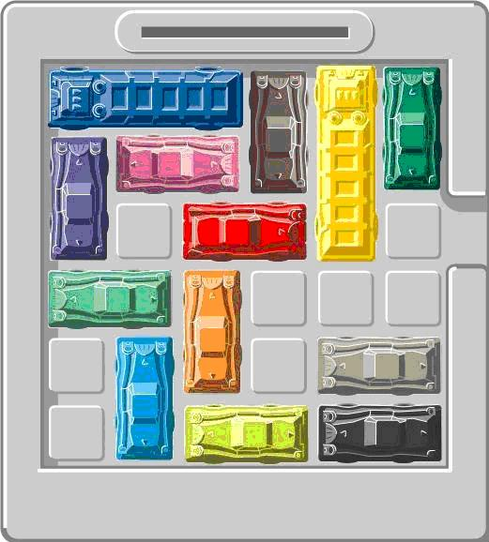
Rushhour
Kyra Kieskamp & Oscar Keur

Slide 2

Rushhour game
Goal: move the cars with the least amount of steps, so the red car can exit the field
One step is changing a cars position
  Moving a car multiple tiles?

Slide 3
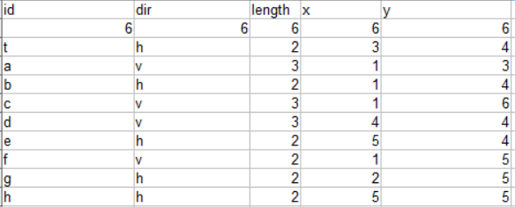
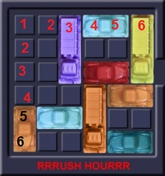
Data input
Board and cars

Slide 4
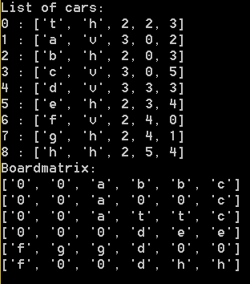
Data representation in program
cars = [] # list of list with ID, orientation, length, y and x
Rmatrix = [[]] # List of list representing a matrix

Slide 5
Steps so far
Initialization board
Updating board
Checking for valid moves
  Position is on the board
  Position is free
Creating possible moves
Choosing one of the possible moves
Perform a single move

Slide 6
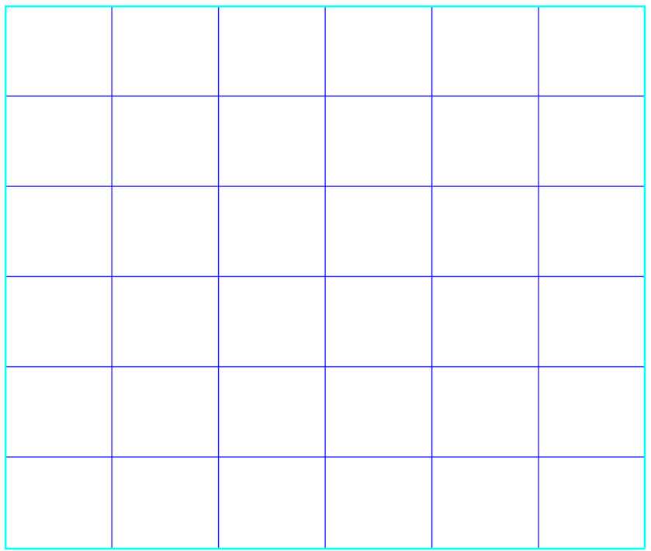
Work in progress
Visualization fully working
Random movement of cars
  Automate a series of moves

Slide 7
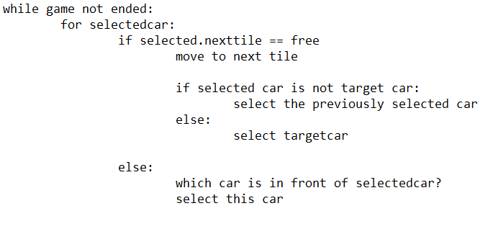
Advanced algoritm
Front
Select
Remember
Select
Free

Slide 8
